Slide 1
Minor Prophets
2022-01-02
Richard Anderson

Slide 2
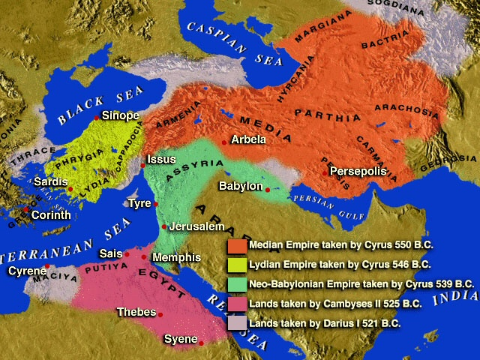

Slide 3
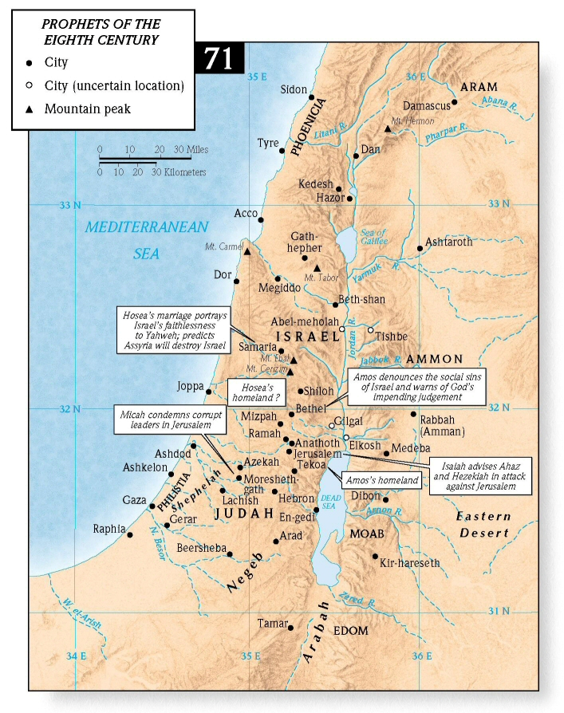
Jonah
West: Tarshish
East: Ninevah
Obadiah

Slide 4
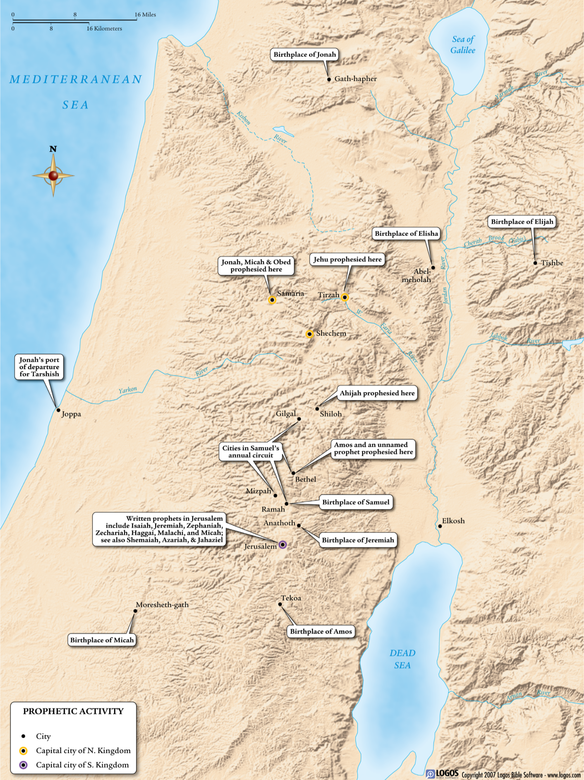

Slide 5
V pattern: sin, wrath & redemption
S↓ Hosea
S↓ Joel
S↓ Amos
S↓ Obadiah
S↓ Jonah
S↓ Micah
R↑ Malachi
R↑ Zechariah
R↑ Haggai
W↑ Zephaniah
W↑ Habbakkuk
W↑ Nahum

Slide 6
Minor prophets: keywords
Anger
Covenant
Day of the Lord (Yahweh)
Exile
Fear of the Lord
Forth-tellers & Fore-tellers
Judgement & Justice
Mercy
Divine Righteousness
Righteous/Faithful will Survive
Rebirth
Redemption
Rebuilding
Catchwords: opening & closing

